Slide 1

CSCI 4237
Software Design for Handheld Devices
Lecture 2 - Android Basics
Mike Cobb

Slide 2
Today
Miscellaneous Items
Homework Assignment Last week
Logging
Strings
Layout using XML/Linear Layout
Radio buttons
Checkboxes

Slide 3
Admin on First Assignment
Overall, most that submitted the work nailed it!
Summarize both the in-class exercise and the Homework-maybe more emphasis on the homework
Include screenshots of the product
Feedback to me: Slow down

Slide 4
MISC items
Changing images
imageView.setImageResource(R.drawable.<image>)
Formatting float/Double (money 2 decimal points)
Textview.txt=“$ %.2f”.format(number)
Wiping the emulator-exit the emulator

Slide 5
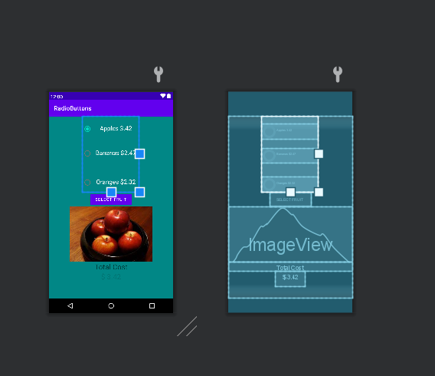
MISC
Design, Blueprint or both?
Select multiple views and set attribute

Slide 6
Viewing Logs
If you have a Exception (e.g. from a try-catch block), you can log it in red text by using Log.e: Log.e(“MyActivity”, “Something bad happened”, exception)
Create your own
Log.d(“checkboxActivity”, “checkbox 2 checked”)
Log.d(“checkboxActivity”, “checkbox 2 unchecked”)

Slide 7
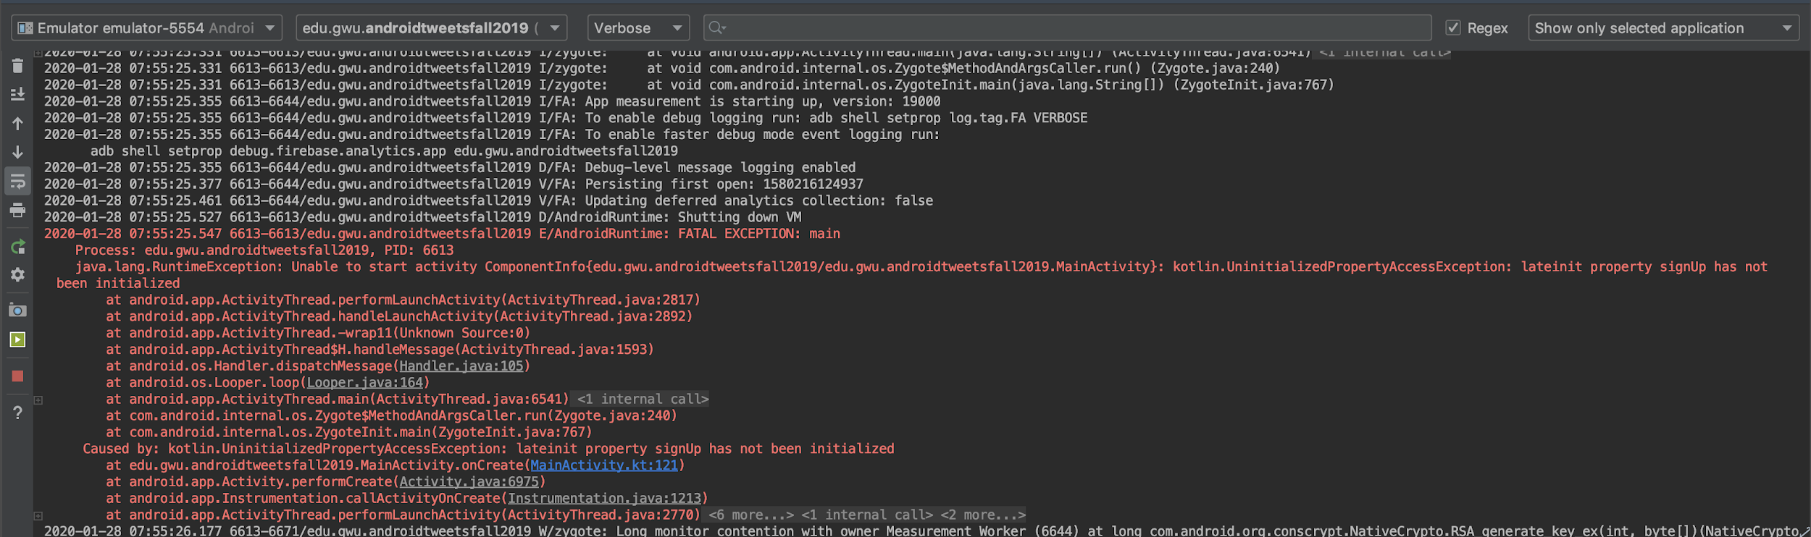
Logging and Viewing Logs
Use the logcat tab in Android Studio to view debug logs (e.g. print statements) and also crash / error stacktraces.

Slide 8
Logging Tips
Make sure you have your current emulator selected

Slide 9
Logging Tips
You can filter for a specific application (select its package and set the filter)

Slide 10
Logging Tips
You can filter for the type of log message (e.g. errors)

Slide 11
Logging Tips
Crash / error messages look like Java stacktraces and will contain a blue hyperlink to the spot in your code that caused the crash.

Slide 12
Logging Tips
Other helpful buttons: a screenshot button and a screen recorder!

Slide 13
HW 2 due next Monday night
You are going to develop a single Activity (One Screen) Menu app where the customer has to select items in two different ways.
The first choice is a choice of one and only one of a group of options (Radio button). The second choice is a choice of 0 to many of a group of options (checkboxes).
The user should have a choice of at least 3 radio button options and 4 checkbox options.
all sections should have a unique price associated.
There should be a total cost displayed after the user completes their selections.
You may add images, buttons, background colors, etc.

Slide 14
Next Week
Starting a second Activity
Passing data between activities
Dialogs/notifications

Slide 15
Backup

Slide 16
Helpful Links
Android Resources
App resources overview
What is the difference between “px”, “dip”, “dp” and “sp”?
Support different pixel densities
Project View
Projects overview

Slide 17
Helpful Links
ConstraintLayout
Understanding the performance benefits of ConstraintLayout

Slide 18
Kotlin - Shorter Syntax
// Class declaration with constructor and one function
class Point(x: Double, y: Double){
val x: Double = x
val y: Double = y
override fun toString(): String {
return "X = $x, Y = $y"
}
}

Slide 19
Kotlin - Shorter Syntax
// Class declaration with constructor and one function
class Point(x: Double, y: Double){
val x: Double = x
val y: Double = y
override fun toString(): String {
return "X = $x, Y = $y"
}
}
In Kotlin, the primary constructor is defined after the class name.

Slide 20
Kotlin - Shorter Syntax
// Class declaration with constructor and one function
class Point(x: Double, y: Double){
val x: Double = x
val y: Double = y
override fun toString(): String {
return "X = $x, Y = $y"
}
}
This is assigning the values passed into the constructor to actual member variables.

Slide 21
Kotlin - Shorter Syntax
// Class declaration with constructor and one function
class Point(x: Double, y: Double){
val x: Double = x
val y: Double = y
override fun toString(): String {
return "X = $x, Y = $y"
}
}
Like Java, classes can contain whatever functions they need (in this case, overriding the default toString())

Slide 22
Kotlin - Shorter Syntax
// Class declaration with constructor and one function
class Point(x: Double, y: Double){
val x: Double = x
val y: Double = y
override fun toString(): String {
return "X = $x, Y = $y"
}
}
Kotlin also has “String templates” instead of doing String concatenation

Slide 23
Kotlin - Shorter Syntax
// Class declaration with constructor and one function
class Point(x: Double, y: Double){
val x: Double = x
val y: Double = y
override fun toString(): String {
return "X = $x, Y = $y"
}
}
This part (assigning constructor values to variables) can also be shortened into one line.

Slide 24
Kotlin - Shorter Syntax
// Class declaration with constructor and one function
class Point(val x: Double, val y: Double){
override fun toString(): String {
return "X = $x, Y = $y"
}
}

Slide 25
Kotlin - Shorter Syntax
class Point(val x: Double, val y: Double){
// You can have additional constructors defined inside
// the class, but they have to ultimately call up to
// your “primary” constructor
constructor(x: Double) : this(x, 0.0)
override fun toString(): String {
return "X = $x, Y = $y"
}
}

Slide 26
Kotlin - Shorter Syntax
val origin = Point(0.0, 0.0)
// Accessing individual fields
val originX = origin.x
val originY = origin.y

Slide 27
Kotlin - Lambdas
// Lambdas define a block of code that can execute *later*
// or *on-demand* and can be passed to functions like
// variables
val lambda = {
System.out.println("Hello world!")
}
// “Execute” the lambda
lambda.invoke()

Slide 28
Kotlin - Lambdas
// Their type format == (parameters) -> return type
val lambda: () -> Unit = {
System.out.println("Hello world!")
}
// “Execute” the lambda
lambda.invoke()

Slide 29
Kotlin - Lambdas
// We give a name “number” to the Int variable passed
// to this lambda. It takes an Int and evaluates to
// a Boolean by determining whether or not it’s even.
val isEven: (Int) -> Boolean = { number ->
number % 2 == 0
}
val isFourEven = isEven.invoke(4)
// Alternate way to invoke
val isFiveEven = isEven(5)

Slide 30
Kotlin - Lambdas
// We give a name “number” to the Int variable passed
// to this lambda. It takes an Int and evaluates to
// a Boolean by determining whether or not it’s even.
val isEven: (Int) -> Boolean = { number ->
number % 2 == 0
}
val isFourEven = isEven.invoke(4)
// Alternate way to invoke
val isFiveEven = isEven(5)
Don’t need the “return” keyword,
the final line in a lambda is what it evaluates to (returns).
Like a function, a lambda can be multiple lines long, if needed.

Slide 31
Kotlin - Lambdas
// Compare to the function version
val isEven: (Int) -> Boolean = { number ->
number % 2 == 0
}
fun isEven(number: Int): Boolean {
return number % 2 == 0
}

Slide 32
Kotlin - Passing Lambdas
// Take advantage of the fact that we can pass lambdas to functions
// this function takes simple lambdas as a parameter and benchmarks how long
// they take to execute
fun benchmark(block: () -> Unit) {
System.out.println("Starting benchmark...")
val start = System.currentTimeMillis()
block()
val elapsed = System.currentTimeMillis() - start
System.out.println("... done - operation took $elapsed ms")
}
Notes:
Example:
fun main(args: Array<String>) {
val nums = List(1000) {
Random().nextInt(1000000)
}
benchmark {
nums.sorted()
}
benchmark {
nums.binarySearch(element = 8470, fromIndex = 0, toIndex = nums.size)
}
}
fun benchmark(block: () -> Unit) {
println("Starting benchmark...")
val start = System.currentTimeMillis()
block.invoke()
val elapsedTime = System.currentTimeMillis() - start
println("... it took: $elapsedTime ms")
}

Slide 33
Kotlin - Passing Lambdas
fun downloadFile(url: String, onComplete: (File) -> Unit) {
// ... go download file at `url` from internet in a *background thread* ...
val myFile: File = ...
// when finished, invoke the lambda so the caller can process the result
onComplete.invoke(myFile)
}
fun main(args: Array<String>) {
val fileUrl = "https://www.example.com/myFile.txt"
val syllabusUrl = "https://www.example.com/syllabus.pdf"
downloadFile(fileUrl) { result: File ->
// ... do something with "myFile.txt"
}
downloadFile(syllabusUrl) { result: File ->
// ... do something with "syllabus.pdf"
}
// While file downloads are pending, we can do something else
showLoadingScreen()
}
Notes:
Example:
fun main(args: Array<String>) {
val nums = List(1000) {
Random().nextInt(1000000)
}
benchmark {
nums.sorted()
}
benchmark {
nums.binarySearch(element = 8470, fromIndex = 0, toIndex = nums.size)
}
}
fun benchmark(block: () -> Unit) {
println("Starting benchmark...")
val start = System.currentTimeMillis()
block.invoke()
val elapsedTime = System.currentTimeMillis() - start
println("... it took: $elapsedTime ms")
}

Slide 34
Kotlin - Lambdas with Lists
val nums = listOf(1, 2, 3, 4, 5, 6, 7, 8, 9, 10)
// Three different ways to print all elements in the list
for (i in nums) {
println(i)
}
// Or: i in 0..nums.size-1
for (i in 0 until nums.size) {
println(nums[i])
}
// Shorthand for a for-each loop, uses a lambda which is called with each element
// “forEach” is actually a function that accepts a lambd
nums.forEach { num ->
println(num)
}

Slide 35
Kotlin - Lambdas with Lists
val nums = listOf(1, 2, 3, 4, 5, 6, 7, 8, 9, 10)
var firstEven: Int? = null
for (num in nums) {
if (num % 2 == 0) {
firstEven = num
break
}
}
// Same as above, but shorter:
// `find` calls the lambda on each element. The lambda is
// required to be a Boolean expression. It stops when the first
// `true` is evaluated.
val firstEven2 = nums.find { num -> num % 2 == 0 }
println(firstEven2)

Slide 36
Kotlin - Lambdas with Lists
val nums = listOf(1, 2, 3, 4, 5, 6, 7, 8, 9, 10)
// `filter` is like `find`, but it returns all elements which evaluate
// to `true` in a List.
val allEvens = nums.filter { num -> num % 2 == 0 }
println(allEvens)

Slide 37
Kotlin - Nullability
// .split(" ") will return ["This", "is", "CSCI", "4237", ... ]
val words = "This is CSCI 4237 Software Design for Handheld Devices and I am Nick Capurso".split(" ")
// Find the first word larger than 6 and print its length
val firstLargeWord = words.find { word -> word.length > 6 }
val length = firstLargeWord.length
println("Length of first large word: $length")

Slide 38
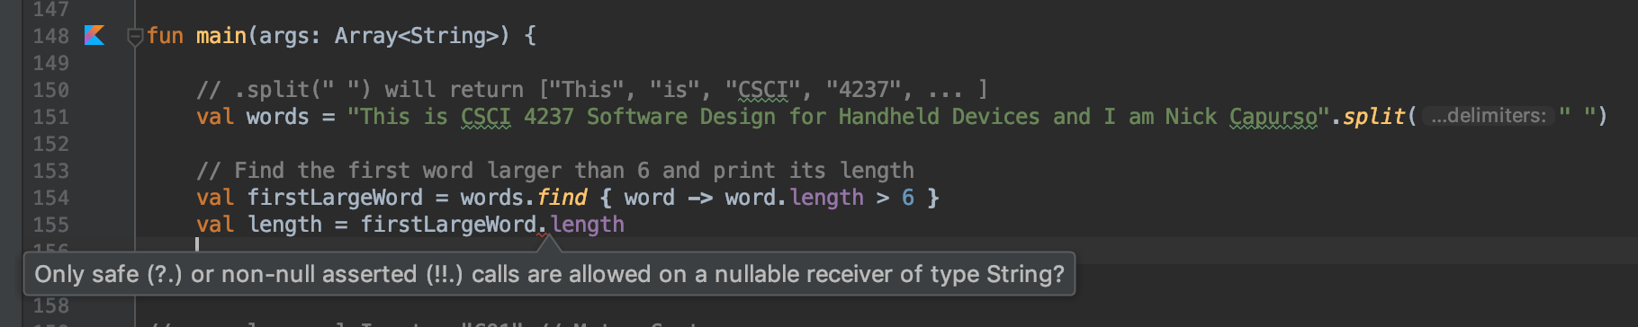
Kotlin - Nullability
This code actually won’t compile as-is:

Slide 39
Kotlin - Nullability
find returns a nullable String in this case (null if there’s no matching elements in the list, non-null otherwise)

Slide 40
Kotlin - Nullability
Kotlin forces you to write safe-code and avoid NullPointerExceptions.

Slide 41
Kotlin - Nullability
// Find the first word larger than 6 and print its length
val firstLargeWord = words.find { word -> word.length > 6 }
// Required null-check
if (firstLargeWord != null) {
// Now this line of code is allowed - the compiler is smart
// enough to recognize that you did a null check!
val length = firstLargeWord.length
println("Length of first large word: $length")
} else {
println("No large words found!")
}

Slide 42
Kotlin - Nullability
// Find the first word larger than 6 and print its length
val firstLargeWord = words.find { word -> word.length > 6 }
// You can use the shorthand .? to say if not null, call the
// function. Otherwise, null is assigned
val length = firstLargeWord?.length
// But now length is nullable
if (length != null) {
println("Length of first large word: $length")
} else {
println("No large words found!")
}

Slide 43
Kotlin - Nullability
// Find the first word larger than 6 and print its length
val firstLargeWord = words.find { word -> word.length > 6 }
// Another shorthand ?: works like the ternary operator
// (if null, the expression uses the second value)
val length = firstLargeWord?.length ?: -1
// Prints -1 for the length if not found
println("Length of first large word: $length")

Slide 44
Extra Links
Kotlin
Kotlin Official Reference
Udacity: Kotlin (free)
Google I/O ‘17: Intro to Kotlin
Git (next lecture)
Intro to Git
Learn Git Branching
Pro Git online book
Steps from Cloning → Making a Pull Request (My Blog Post)

